Slide 1
Number Plate Detection:
A Project on Vehicle Number Plate Detection
Aryan Rai
Devendra M. Tiwari

Slide 2
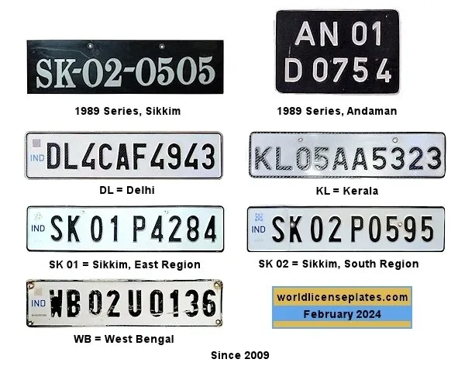
Introduction
The advancements in vehicle detection technology have revolutionized the automotive industry. This presentation will help you to find out about our project related to Number Plate Detection which can extract Vehicle Registration Number from Number Plate.

Slide 3
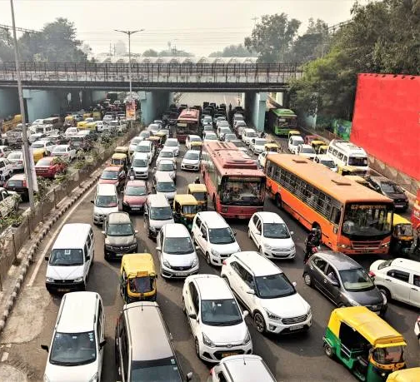
Problem Statement
Develop a system that can accurately detect and extract vehicle license plates from a given image.

Slide 4
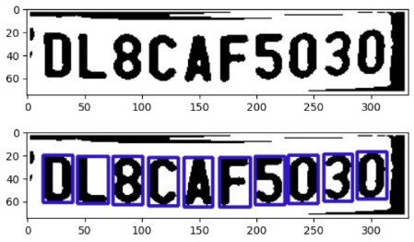
Implementations
To detect an object(license plate) from an image we need another tool that can recognize an Indian license plate so for that I’ve used Haar cascade, pre-trained on Indian license plates
Analyzing and performing some image processing on the License plate Using OpenCV’s grayscale, threshold, erode, dilate, contour detection and by some parameter tuning, we may easily be able to generate enough information about the plate

Slide 5
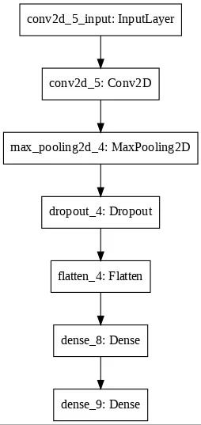
Technical Info:
Programming Languages: Python
Python Libraries: Opencv, matplotlib, tensorflow, Kera etc.
Model detail : 4 Layer (Conv2D), Max Pooling, Dropout, 2 Dense Layer.
IDE : Google Colab
Haar Cascade for Number plate Detection

Slide 6
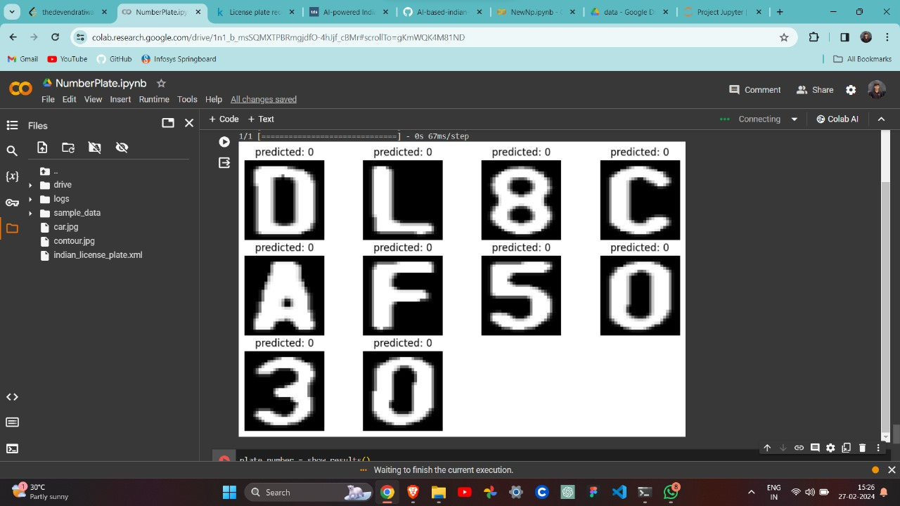
Results
Model Accuracy is around 95% accurate.
The model is extracting Number Plate image from input image.
We are successful in printing the number from the Number Plate.

Slide 7
Conclusion
In this model, we are able to extract the image and registration number from the Number plate.
In this model, we have large scope of improvement and feature implementation.
Thank You!

